Slide 1
Application in Finance II Topological Data Analysis
Machine-Learning-based Market Crash Early Indicator and How TDA Can Boost the Performance at High Cut-offs

Slide 2
Content
The Problem 1.0
The Results 1.0
The Data
The Model
The Problem 2.0
Recap on TDA Intro
The Results 2.0
The Results in details

Slide 3
The Problem 1.0 - Motivation
Market moves in cycles: spikes followed by crashes, vice versa
There are handful of “crash” indicators summarised by practitioners from experience:
Yield Spreads: 2-10 year, CDS
Commodity and Rates: Gold and Treasury Bonds as flight-to-safety
Volatility spikes
Sectorial Rotations
In the AI/ML era, leveraging the expanded amount of data and computing power, Financial Machine Learning is gathering momentum to augment our insights in understanding market crashes

Slide 4
The Problem 1.0
Based on the public data, can we develop an ML-powered market crash indicator to quantify the risk of market crashes in a given forecasting window (e.g. 2w), in terms of probability?
Something has been done:
“Predicting stock market crashes” – Roman Moser, Jan 2019
“Forecasting stock market crisis events using deep and statistical machine learning techniques” - Sotirios P. Chatzis et al. June 2018

Slide 5
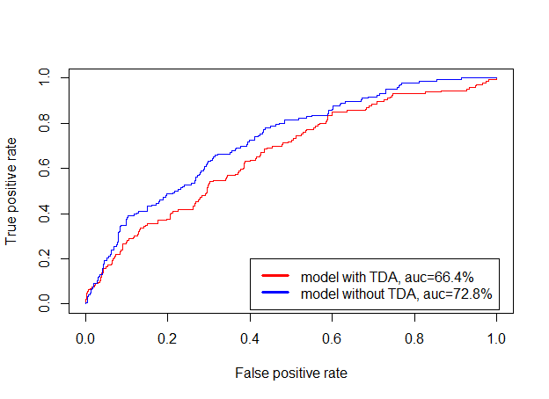
The Results 1.0
AUC Score (on Hang Seng Index down > 5% in 2w) = 72.8%

Slide 6
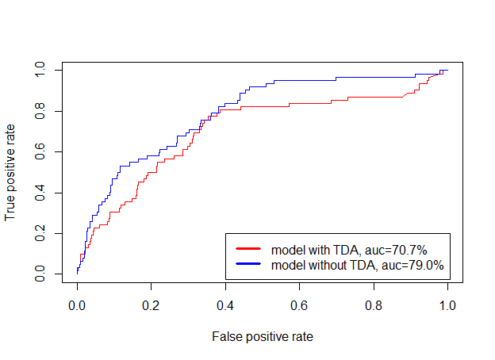
The Results 1.0
AUC Score (on S&P 500 down > 5% in 2w) = 79.0%

Slide 7
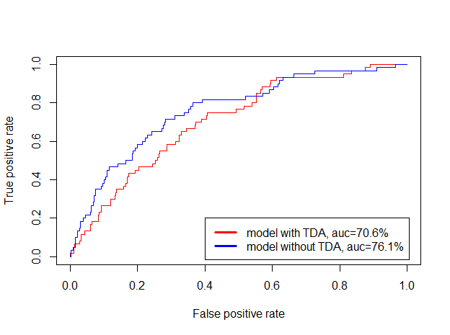
The Results 1.0
AUC Score (on FSTE 100 down > 5% in 2w) = 76.1%

Slide 8
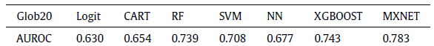
The Results 1.0
Comparable to the results in the “Chatzis et al” paper (2nd reference paper above):
However, “Financial Machine Learning” and “Market Crashes” are also biased to false positives at the high cut-offs

Slide 9
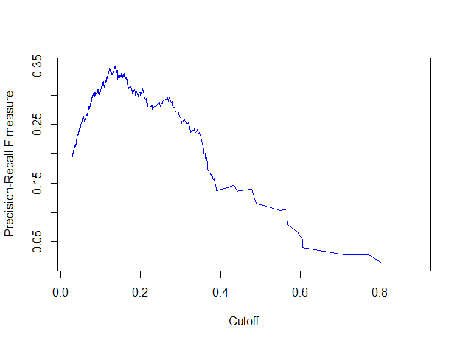
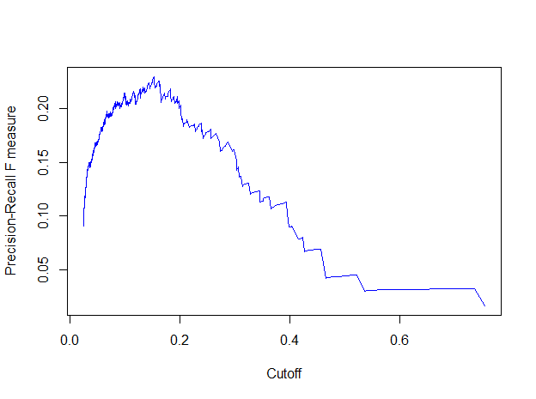
The Results 1.0
F1 vs. Cutoff (on HSI down > 5% in 2w)
F1 vs. Cutoff (on S&P 500 down > 5% in 2w)

Slide 10
The Data
35 years of weekly price (covering major crashes since 1983)
Asset types covering: Equity, FI, FX, Commodities (& Fama French Factors)
Parsimonious approach to Feature Engineering (→ c. 10 features/dimensions):
Return/Change/Momentum features
Spread features
Volatility features
Meta parameters:
forecast window = 2w
TH = 5% (i.e. Y=1 for chosen index drop > 5%, Y=0 otherwise)
training batch window = 26w
rolling step size = 1w
→ c. 3000 data points in total

Slide 11
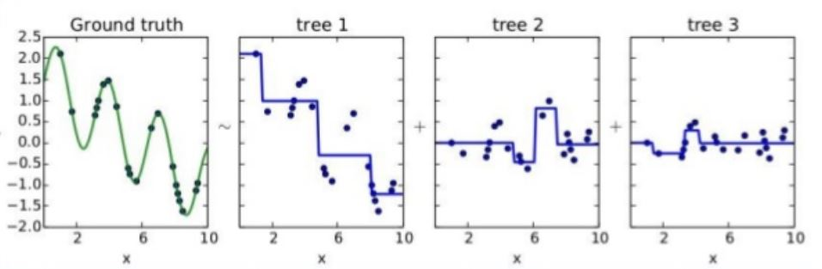
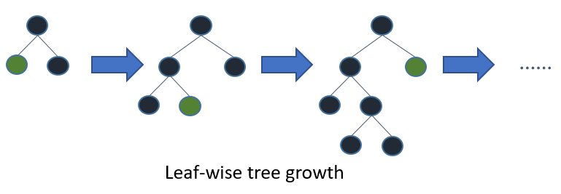
The Model
Best Results vs. SVM vs. CNN vs. Regression
Tree-based
Transparent and whitebox as regression vs. deep neural networks
Free from normalisation/standardisation of the features vs. regression
Kagglers’ love (used by 17 out of 29 winners)

Slide 12

The Model
“Online” Learning:
Roll 2w of data
Return/Change Features
Return/Change Features
XGBoost Model
(Training)
XGBoost Model
(Testing)
Y:
Ground Truth
Spread Features
$Y$:
Prediction
Spread Features
Volatility Features
Volatility Features

Slide 13
The Problem 2.0
How do we improve the model performance at high cutoffs?
Beyond all the conventional features/market factors, are we missing anything actually matters?

Slide 14

Recap on Topological Data Analysis
Topologists perhaps are best defined as the people with “disability” to tell doughnuts from mugs or vice versa:

Slide 15

Recap on Topological Data Analysis
“Data has shapes, shape matters.” - Ayasdi

Slide 16
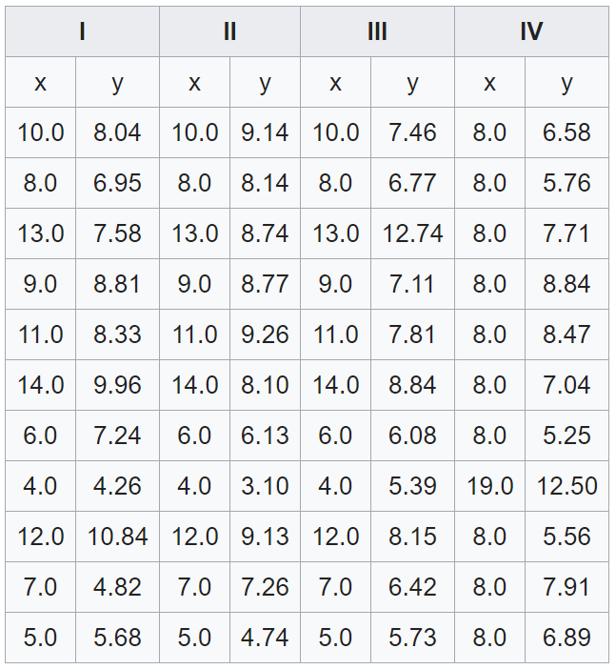
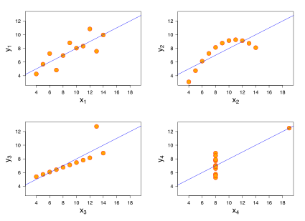
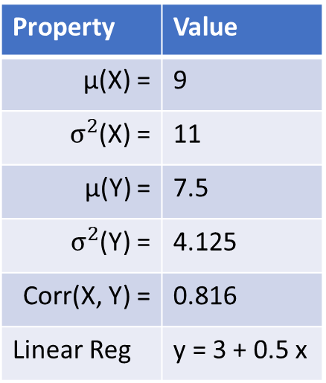
Recap on Topological Data Analysis
Property | Value
µ(X) = | 9
$σ^{2}$(X) = | 11
µ(Y) = | 7.5
$σ^{2}$(Y) = | 4.125
Corr(X, Y) = | 0.816
Linear Reg | y = 3 + 0.5 x

Slide 17

Recap on Topological Data Analysis

Slide 18
The Model
“Online” Learning:
Roll 2w of data
Return/Change Features
Return/Change Features
Spread Features
Spread Features
XGBoost Model
(Training)
XGBoost Model
(Testing)
Y:
Ground Truth
$Y$:
Prediction
Volatility Features
Volatility Features
TDA Features
TDA Features

Slide 19
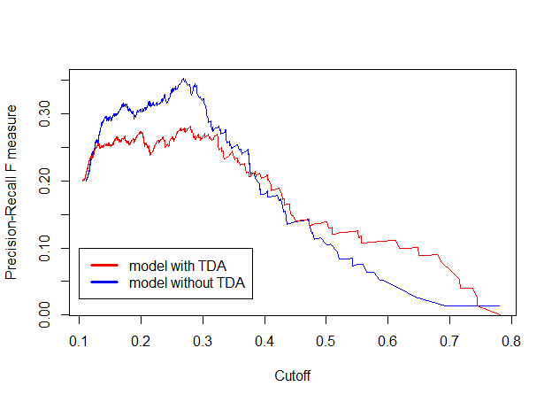
The Results 2.0 – HSI

Slide 20
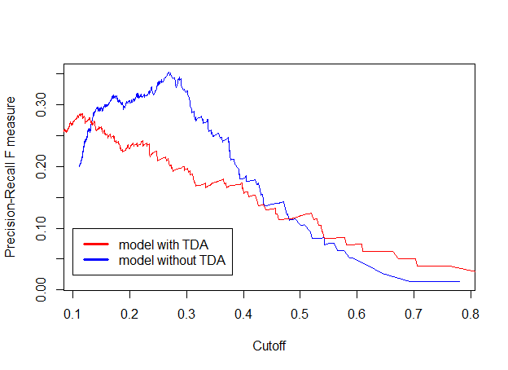

The Results 2.0 – S&P 500

Slide 21
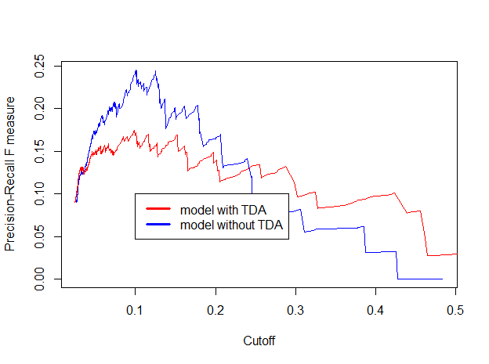
The Results 2.0 – FTSE 100

Slide 22
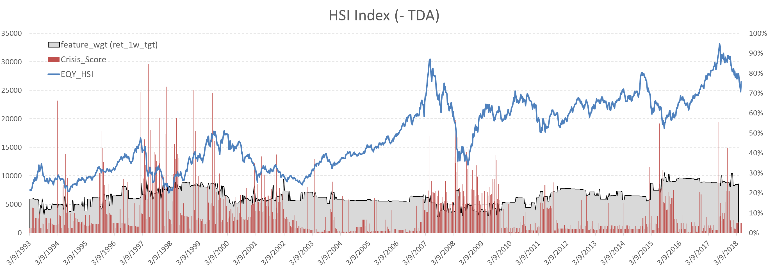
The Results in Details: HSI (-TDA)

Slide 23
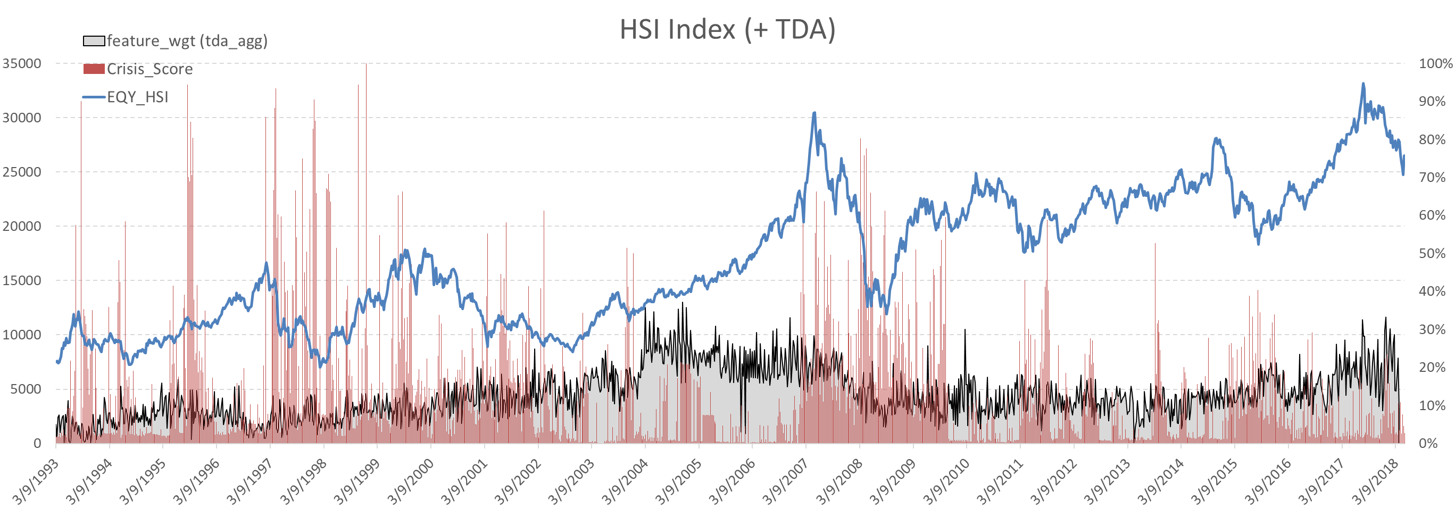
The Results in Details: HSI (+TDA)

Slide 24
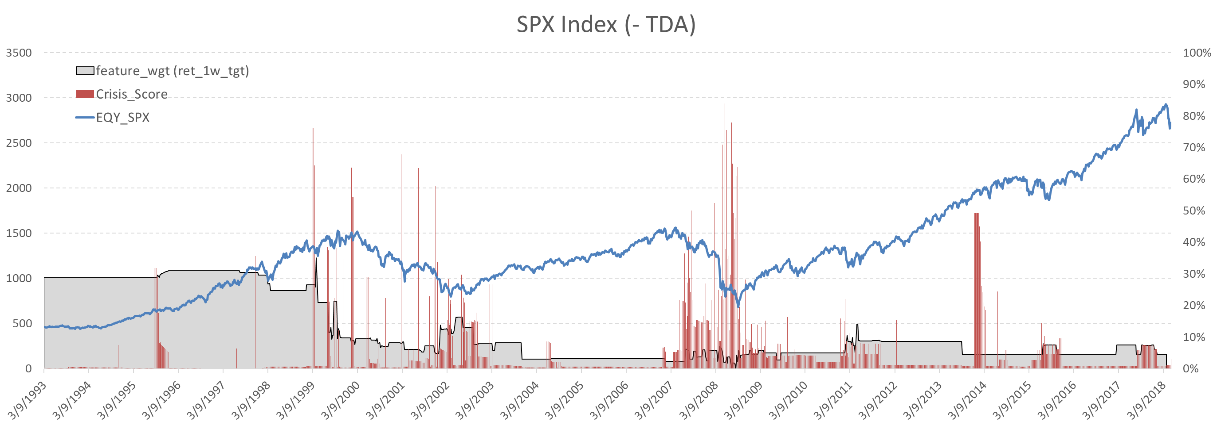
The Results in Details: S&P 500 (-TDA)

Slide 25
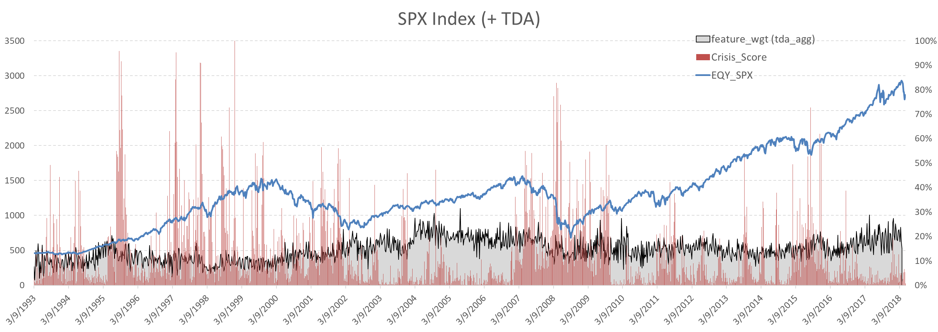
The Results in Details: S&P 500 (+TDA)

Slide 26
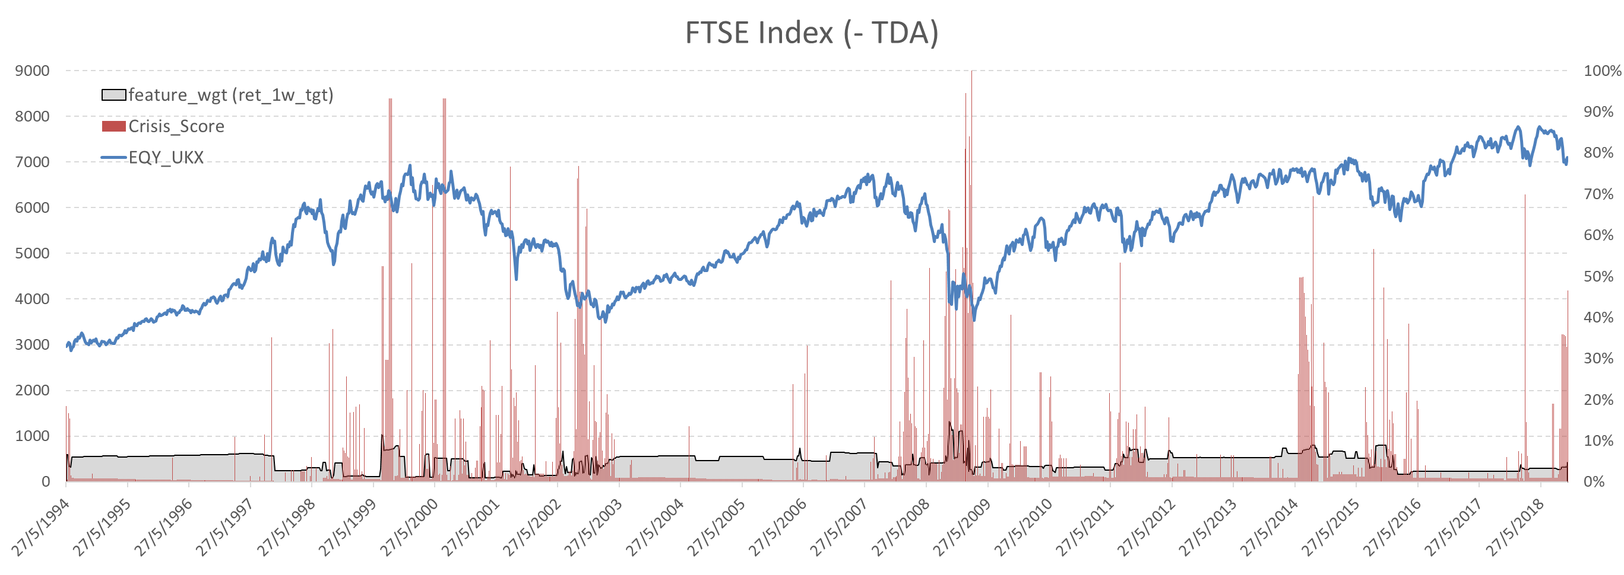
The Results in Details: FTSE 100 (-TDA)

Slide 27
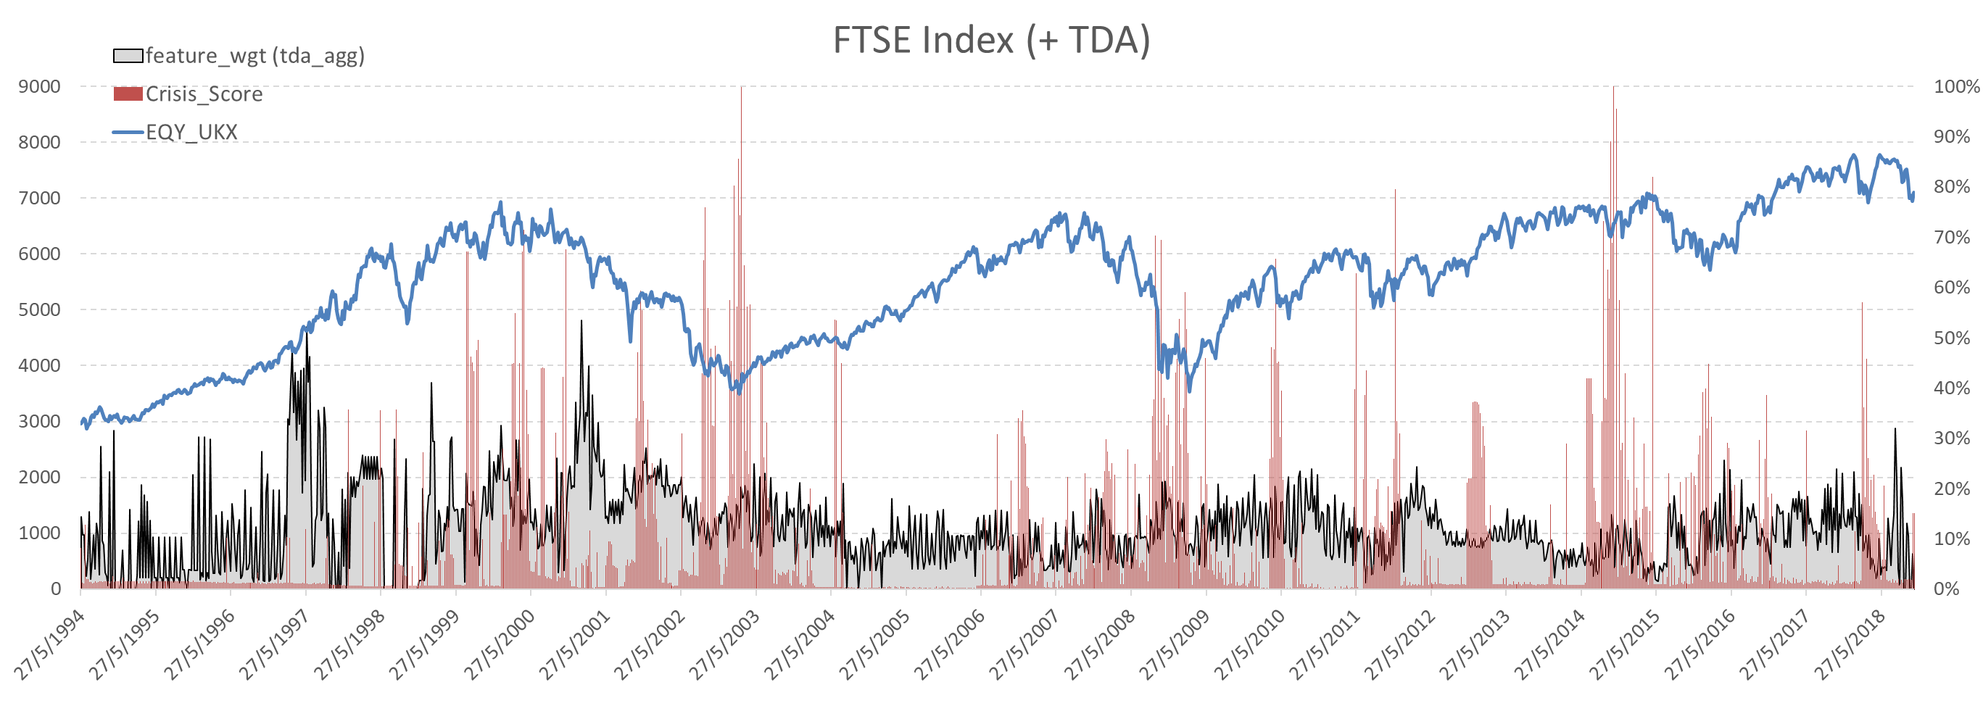
The Results in Details: FTSE 100 (+TDA)

